Slide 1
Quality Control Plan
Dr Sally Priest, Flood Hazard Research Centre
6th April 2017

Slide 2
Quality Control Structure
Work Package and Partner Reports
Quality Assurance Committee (QAC) Reports
Independent Monitoring Evaluations

Slide 3
Work Package (Q) and Partner Reports (R)
Light-touch, self-evaluation
Identification of any shortfalls in direction of planned outcomes
- 65% by 14th October 2017
- 90% by 14th October 2018
- 100% by 14th October 2019
Enable timely mitigation

Slide 4
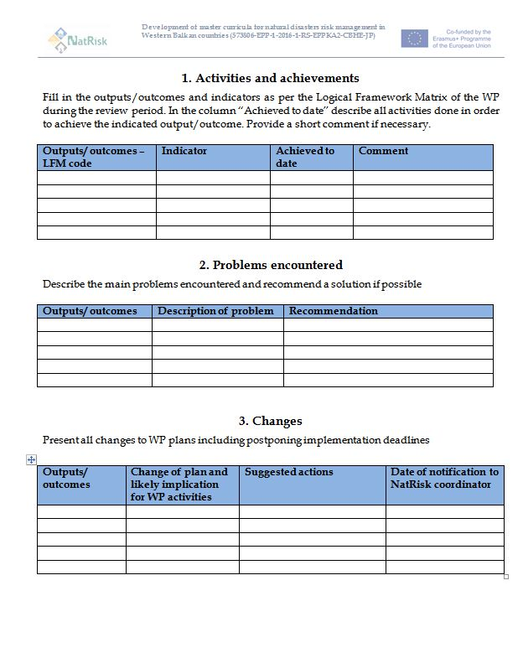
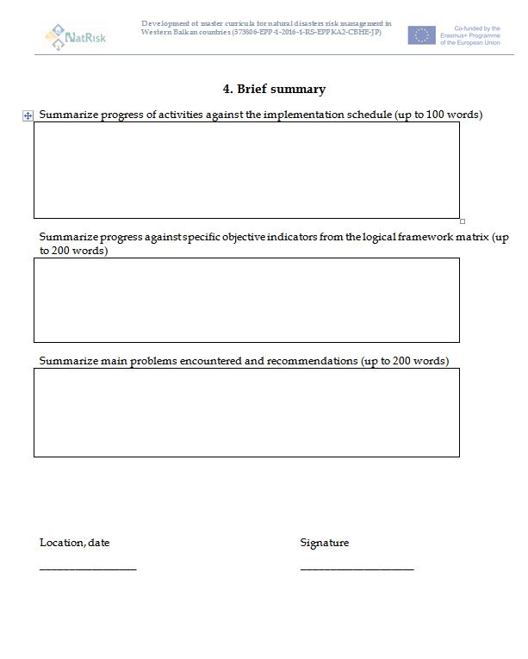
Work Package Self-Assessment Report (Q)
Notes:
Biannual – i.e. twice a year – 30 March and 30th September.

Slide 5
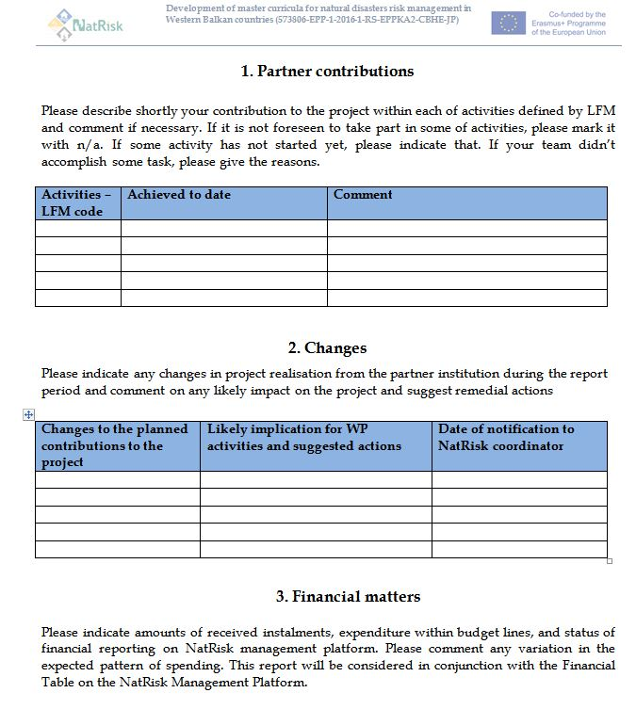
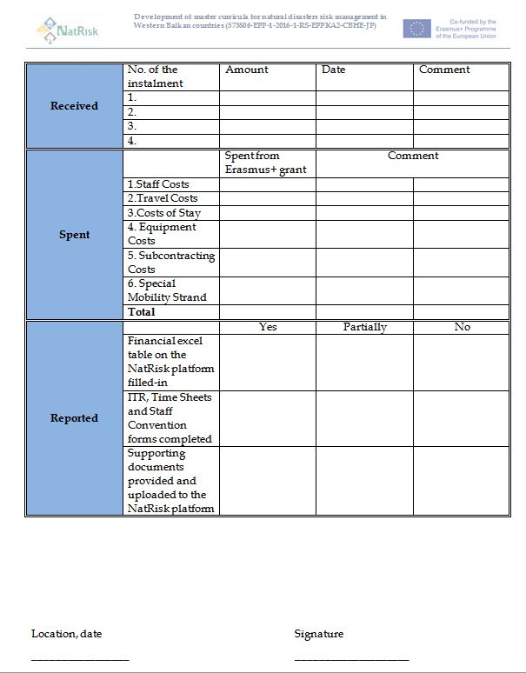
Partner Self-Assessment Report (R)
Notes:
Yearly - on 30th September

Slide 6
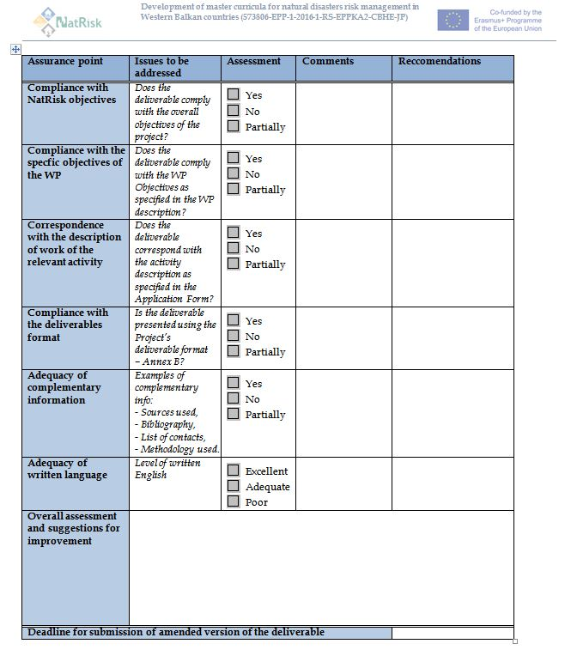
Deliverable Review (S)
Notes:
When required – i.e. within two weeks of the deliverable date. This is the responsibility of the person writing up the deliverable and then reviewed by WP leader and project coordinator

Slide 7
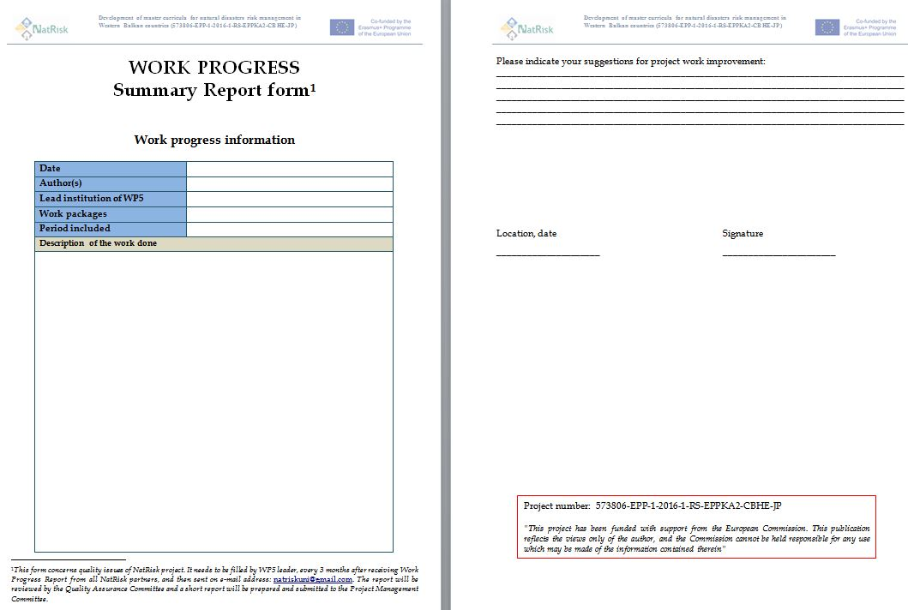
Work Package Summary Report (T)

Slide 8
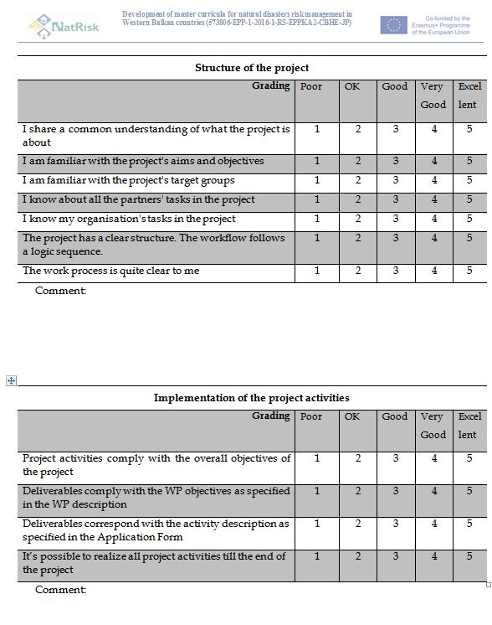
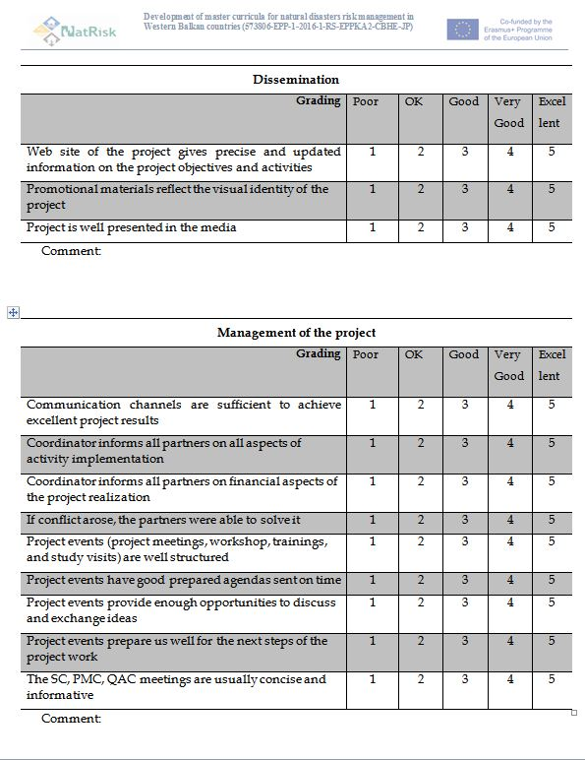
Internal Project Quality Evaluation Form (U)

Slide 9
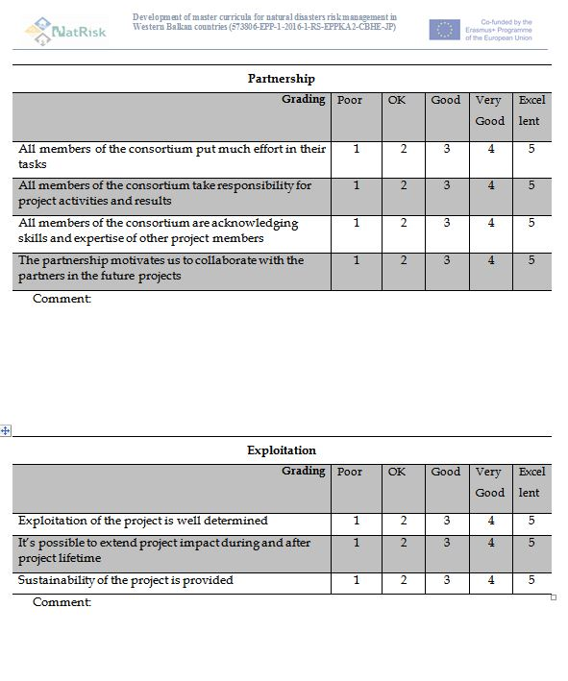
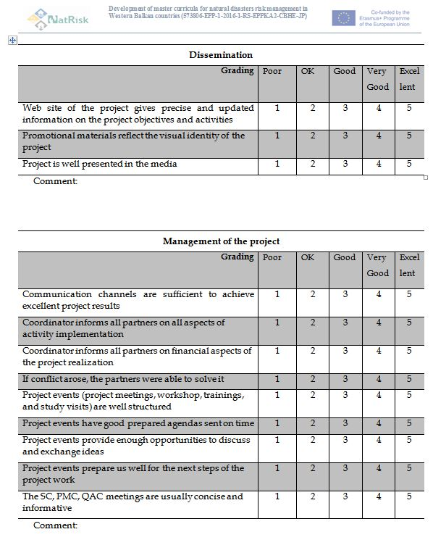
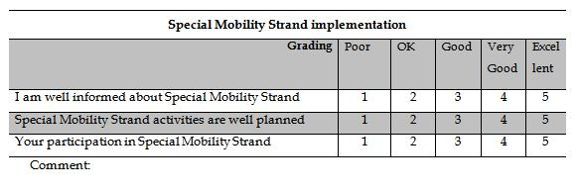
Internal Project Quality Evaluation Form (U)

Slide 10
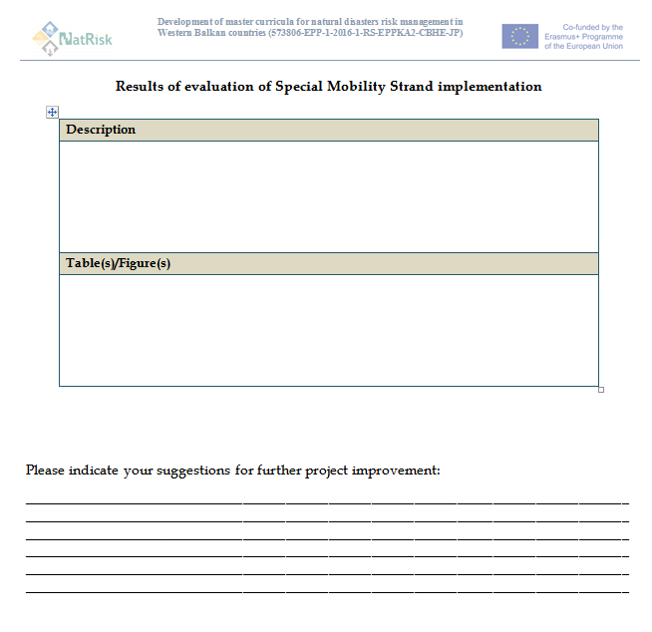
Internal Project Quality Evaluation Form (V)
Structure
Implementation of activities
Dissemination
Management
Partnership
Exploitation
Special Mobility Strand

Slide 11
External review process
Quality evaluation
Two external review points
Project mid-point – May 2018
6 months before end of project
Financial evaluation
Take place during the final year
- Deadline July 2019
To ensure that the project is on track and delivered according to the plan
Advice about improving quality of the project

Slide 12
Quality assurance
Key role of the WPs
The QAC is NOT responsible for the academic content of the project outcomes
WPs for the outcomes need to ensure that they follow the quality standards of the relevant National Quality Agencies for countries implementing in the project
In accordance with the Standards and Guidelines for Quality Assurance in the European Higher Education Area (2015)
http://www.enqa.eu/index.php/home/esg/

Slide 13
A reminder of timings for WP leaders
Work Package Assessment Report (Q) | 30th March 2017 | 30th Sept 2017 | 30th March 2018 | 30th Sept 2018 | 30th March 2019 | 30th Sept 2019
Partner Self-assessment Report (R) |  | 30th Sept 2017 |  | 30th Sept 2018 |  | 30th Sept 2019
Deliverable Review (S) | 2weeks after the completion of any deliverable
Internal Project Quality Evaluation Form (U) |  | 30th Sept 2017 |  | 30th Sept 2018 |  | 30th Sept 2019

